Slide 1
MINING EDUCATION DATA TO PREDICT STUDENT’S ACADEMIC PERFORMANCE USING ENSEMBLE METHODS
Elaf Abu Amrieh, Thair Hamtini and Ibrahim Aljarah
International Journal of Database Theory and Application(2016)

Slide 2
Introduction
Recently there is an increasing research interest in Educational data mining(EDM)
Many data mining are being used to extract the hidden knowledge from education data.
Educational data can be collected from different sources like web-based education, traditional surveys, educational repositories,…
EDM use many DM techniques, the most popular technique to predict an educational model is classification.

Slide 3
Related work
Romero et Al used Decision tree algorithm to predict student’s final marks based on their usage data in the Moodle system.
Arsad et Al used Artificial neural network to predict the academic performance of bachelor’s degree based on grade point of fundamental subject scores.
Other authors used Bayesian network to predict CGPA based on applicant background at the time of admission.

Slide 4
Focus of this research
This paper introduces a student 'performance model with a new category of features called behavioral features.
They used 3 common data mining methods(ANN,NB,DT) to build the student performance model.
After, they applied ensemble methods to improve the performance of those classifiers(bagging, boosting and random forest).

Slide 5
Data collection and preprocessing
The educational dataset was collected from learning management system(LMS) called Kalboard 360.
Data was collected using a tracker tool called experience API (xAPI) .
Dataset contains 500 students with 16 features.

Slide 6
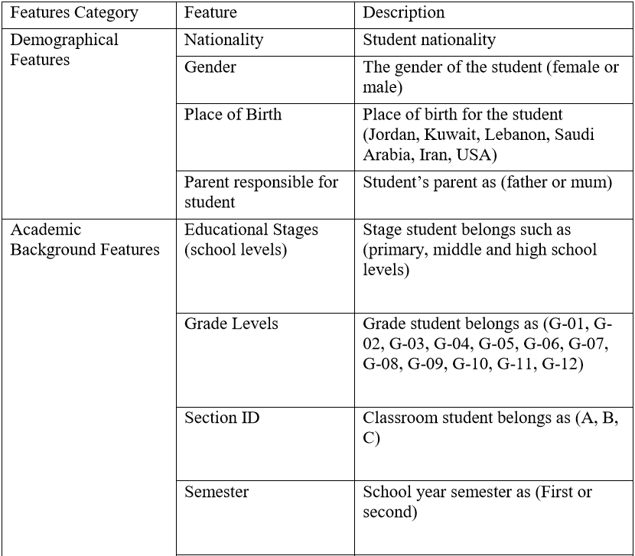
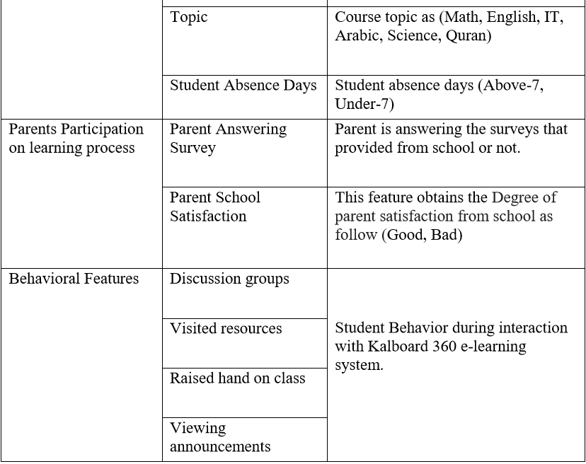
Student features and their description

Slide 7
Feature analysis
Features affecting student performance
Gender
Family background feature
School attendance

Slide 8
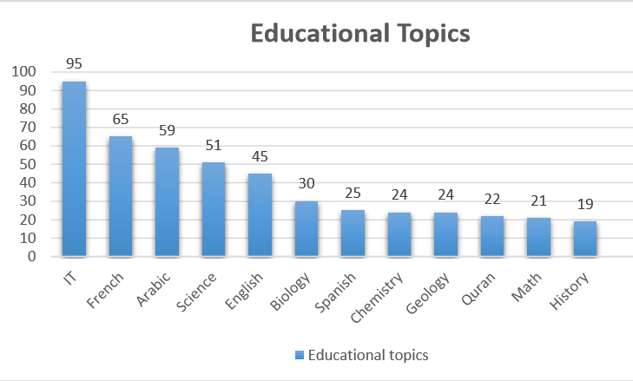
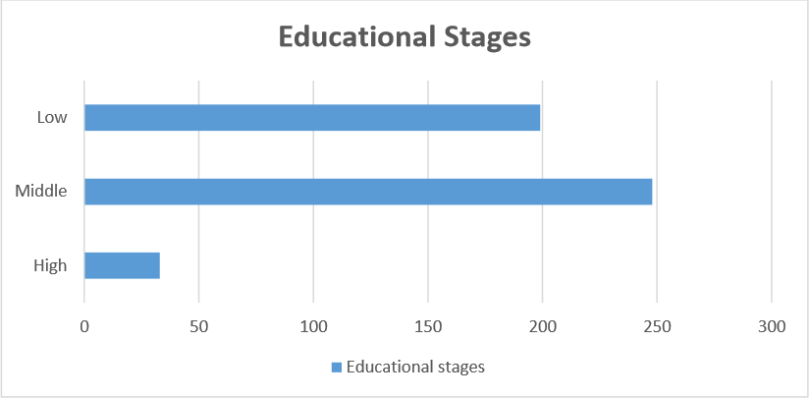
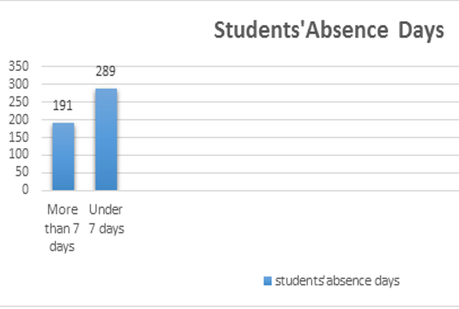
Data preprocessing
Data visualization

Slide 9
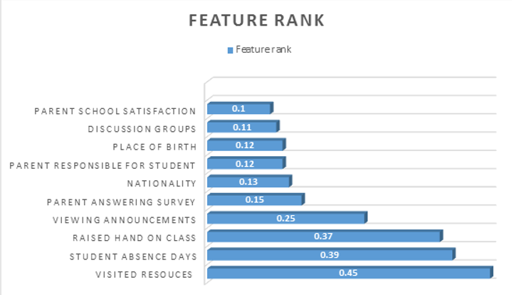
Data preprocessing
Data cleaning
Removing irrelevant items and missing values. Dataset was 500 records, after cleaning dataset became 480 records.
Feature selection
They used filter-based method, using
information gain selection algorithm to evaluate the
feature ranks.
Learner behavior during the education process have an impact on their academic success

Slide 10
Methodology
Student performance model proposed: ensemble methods.
ensemble methods is a learning approach that combine multiple models to solve a problem.
Aim of such approach is to provide an accurate evaluation for the features that may have an impact on student’s academic success.

Slide 11
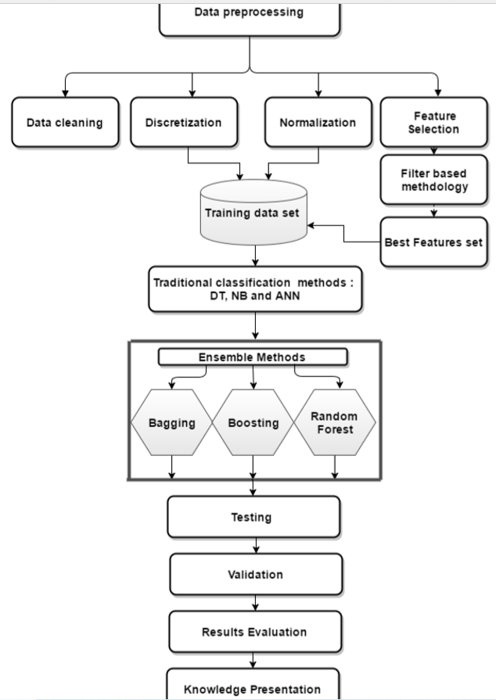
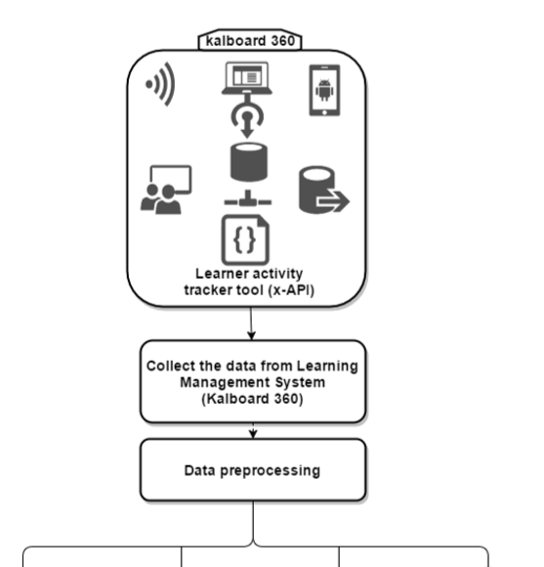
Dependent methods: boosting independent methods: bagging and random forest

Slide 12
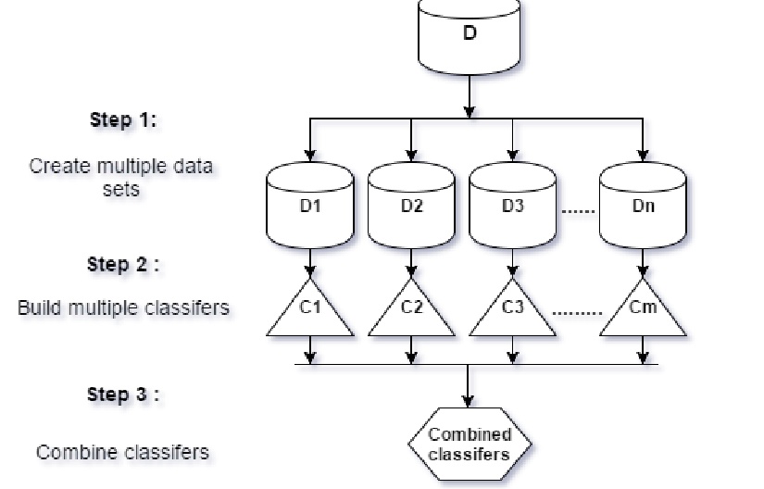
Ensemble methods
Boosting: trains a set of learning models sequentially and focus more on the errors of the previous model.
Bagging and random forest: resample data into samples and each sample is trained by different classifier, after they combine results through voting .

Slide 13
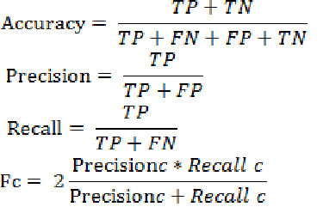
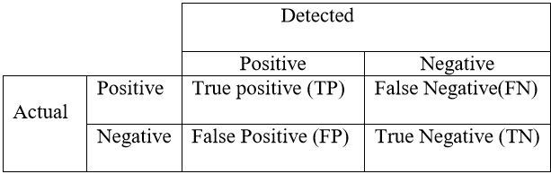


Experiments and results
10-folds cross validation was used to split dataset into training and testing splits.
For the experiments, WEKA tool was used to evaluate the classification models and comparison.
For evaluation of the classification quality, they used 4 measures: accuracy, precision, recall and F-measure.

Slide 14
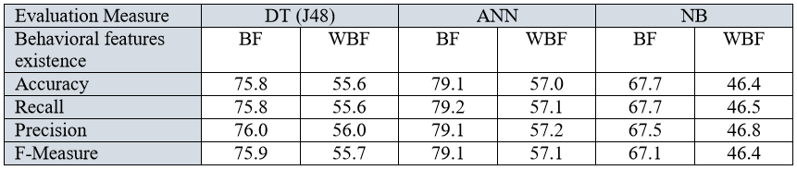
Experiment and results
Using traditional data mining methods
They used 3 classifiers(DT,ANN,NB) with behavioral features(BF) and without BF(WBF)
There is a strong effect of BF on student’s academic achievement

Slide 15
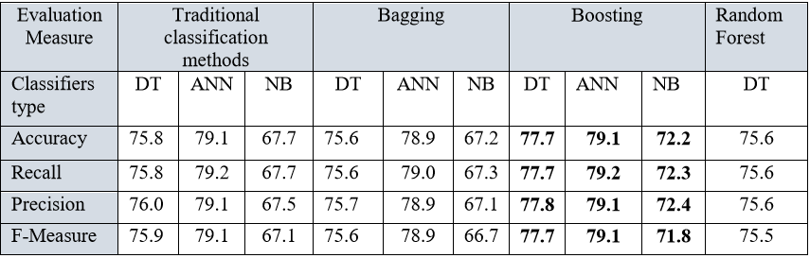
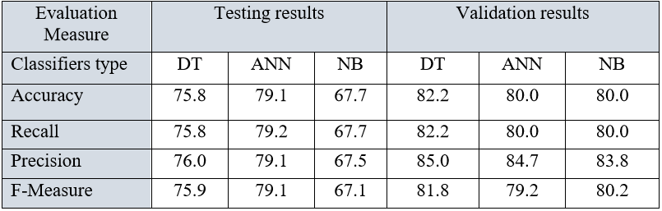
Experiment and results
Using ensemble methods
boosting improved the
results for both DT and NB
Results through testing and validation
The results of the validation
process prove the reliability of
the proposed model

Slide 16
Conclusion and future work
Wide usage of LMS generate large amounts of data about teaching and learning interactions. Those data contains hidden knowledge that could be used to enhance the academic achievement of results.
Regarding on the obtained results, there is a strong relationship between learner’s behaviors and their academic achievement.
The visited resources feature is the most effective on student’s performance.

Slide 17
Conclusion and Future work
Future work: Focusing more on analyzing the behavioral features
This model can help educators to understand learners, identify weak learners, improve learning process, trimming down academic failures rates and can help administrators to improve the learning system outcomes.

